Slide 1


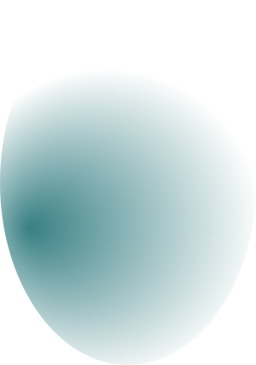
Analyzing the Advances and Limitations of Deepfake algorithms
Author: Omar Alaa
Supervisor: Prof. Dr. Amr Elmougy
Notes:
Hello everyone, my name is Omar Alaa and today I am going to give a quick overview about my bachelor topic which is analyzing the advances and limitations of deepfake algorithms and it was supervised by Professor Amr Elmougy

Slide 2
Introduction
Outline
Deepfakes Creation
Results
Conclusion
German International University
1
Notes:
so this is going to be my outline for this presentation starting by introduction then the methodology then results section and finally the conclusion so before introducing my topic I would like you to watch this video

Slide 3
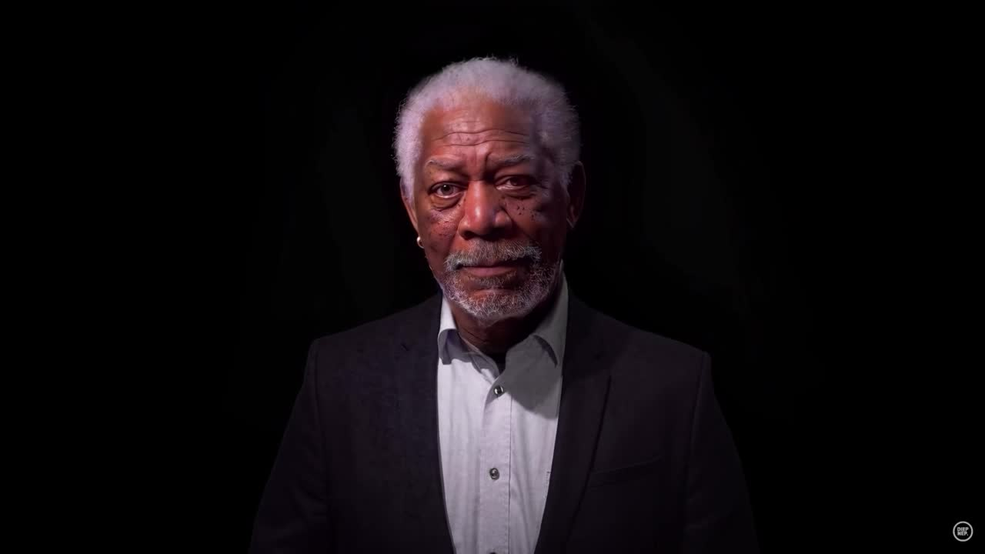
German International University
2

Slide 4
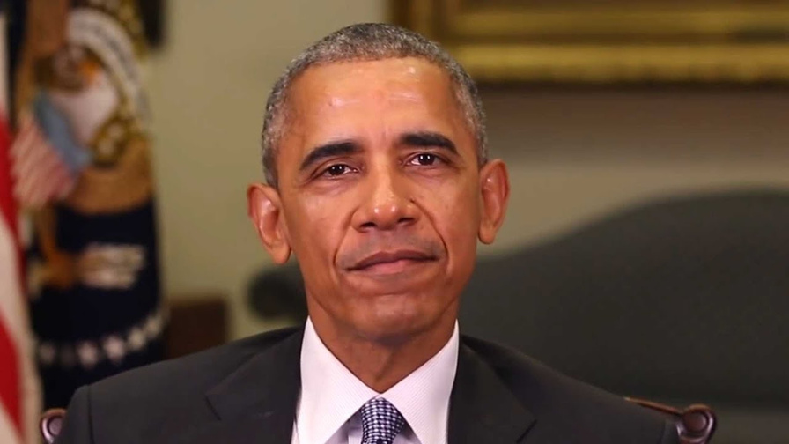
1
What are Deepfakes?
A combination of deep learning and fake data
Introduction
German International University
3
Notes:
so now after seeing the video, i want to let you know that it was a fake video and morgan freeman didn't say a single word from this so what are deep fakes?
deepfakes are basically combination of deep learning technologies applied on fake data and this could lead to political issues and multiple problems due to the misuse of the deepfake technology

Slide 5
2
Deepfakes Creation
Model Architecture
Animation Generation
German International University
4
Notes:
Moving to the methodology section and the creation process of a deepfake videos generator, i'll talk about the architecture, and animation generation part.

Slide 6
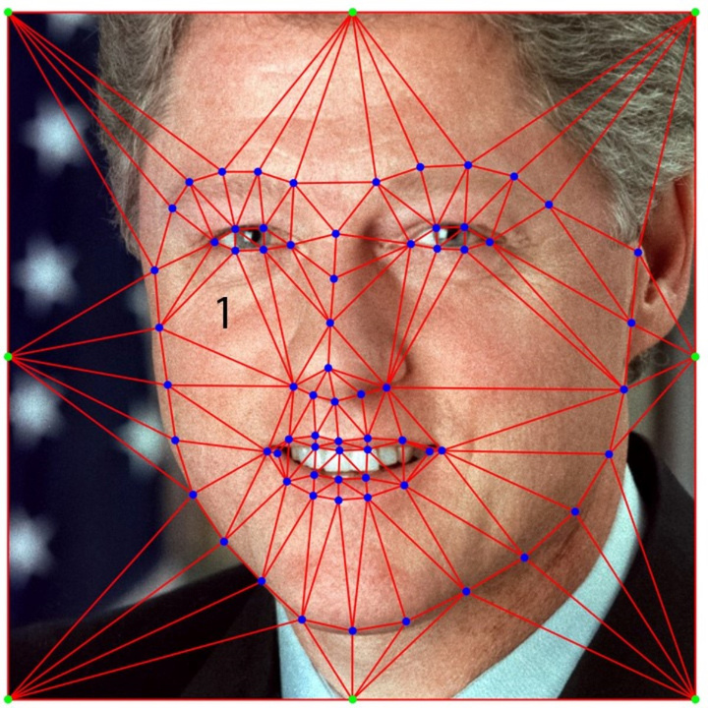
Occlusion Aware Generator
Dense Motion Network
1
Model Architecture
Keypoint Detector
German International University
5
Notes:
so first, the model architecture it's divided into 3 main parts, occlusion aware generator, a dense motion network and a keypoint detector as shown in this photo

Slide 7
2
Keypoints extraction
Animation Generation
Normalization of Keypoints
Frame-by-Frame Generation
Output Generation
German International University
6
Notes:
and for the animation generation the occlusion aware generator is mostly the responsible part for animating the picture by extracting keypoints, normalizing them then generate each frame one by one and concatenating those generated frames

Slide 8
3
Facial Movements
Visual Coherence
Realisim
Results
German International University
7
Notes:
moving to the results section I am gonna talk about 3 aspects let's start by facial movements, so based on my trials the model demonstrates accurate replication of facial movements
and expressions
secondly, Lighting and colors in the animation maintain consistency with the overall
visual context of the driving video
and finally the animation shows an acceptable level of realism and believability but there's a limitation for generating videos that are with many facial movements in the source video like the next video

Slide 9
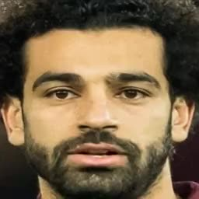
German International University
8

Slide 10
4
Model Architecture
Animating a picture
Final results
Overview for deepfakes
Conclusion
German International University
9
Notes:
finally to conclude the topic, i achieved the thesis objectives and contributed in the field of deep learning in general and deepfakes in particular by working on all the explained steps

Slide 11

German International University
10

